Slide 1


G.H. RAISONI COLLEGE OF ENGINEERING
AND MANAGEMENT, WAGHOLI, PUNE
Department of CSE ( AI & AIML)
Smart Attendance System with Face Recognition
Guide:
Proff. Dhiraj Vyawahare
Name of Projectees
Yash H. Darode Yash K. Bhatkar
Vikrant R. Gawade

Slide 2
Contents
Introduction
Justifications for Selecting the Title
Problem Statement
Literature Survey
Block Diagram
Expected Result
Work plan
References

Slide 3
Introduction
In educational institutions, manual attendance tracking is time-consuming and prone to errors. This project addresses the problem by developing a real-time attendance tracking system using face recognition technology. The system automatically identifies students through live video feeds, encodes facial features, and records attendance in a Firebase database. This approach aims to enhance the efficiency of attendance management while ensuring secure, scalable, and reliable data handling

Slide 4
Justification For Selecting The Title
The chosen title reflects the core objective of the project: real-time attendance tracking facilitated by face recognition technology. With the growing adoption of AI-based systems, this project aligns with modern trends in automation. It addresses practical issues faced in educational institutions and workplaces by leveraging contactless, real-time recognition through cloud integration. The focus on scalability, data security, and anti-spoofing measures justifies the relevance of the project in both academic and real-world contexts

Slide 5
Problem Statement
Traditional attendance methods are prone to issues such as proxy attendance, manual errors, and time-consuming processes. Moreover, in post-pandemic settings, contact-based methods (like fingerprint scanning) have become less favorable. Institutions need a contactless and automated system to mark attendance efficiently. The problem lies in developing a robust facial recognition system that can process live video streams, handle data securely, and prevent fraudulent attendance marking through static images or digital photos.

Slide 6
Literature Survey
Sr. No. | Paper Title and Year | Details of Publication | Findings
1 | FaceNet: A Unified Embedding for Face Recognition and Clustering (2015) | CVPR Conference; Schroff, F., Kalenichenko, D., & Philbin. | Introduced FaceNet, a deep learning-based system for face recognition. Achieved high accuracy by learning a unified embedding of facial features.
2 | Deep Residual Learning for Image Recognition (2016) | CVPR Conference; He, K., Zhang, X., Ren, S., & Sun, J. | Proposed ResNet architecture, improving the performance of deep networks, which is useful for enhancing recognition accuracy in challenging conditions.
3 | MTCNN: Multi-Task Cascaded Convolutional Networks for Face Detection (2016) | IEEE Conference on Computer Vision and Pattern Recognition; Zhang, K., Zhang, Z., Li, Z., & Qiao, Y. | Developed a multi-task cascaded CNN for face detection with high accuracy and efficiency in real-time applications.

Slide 7
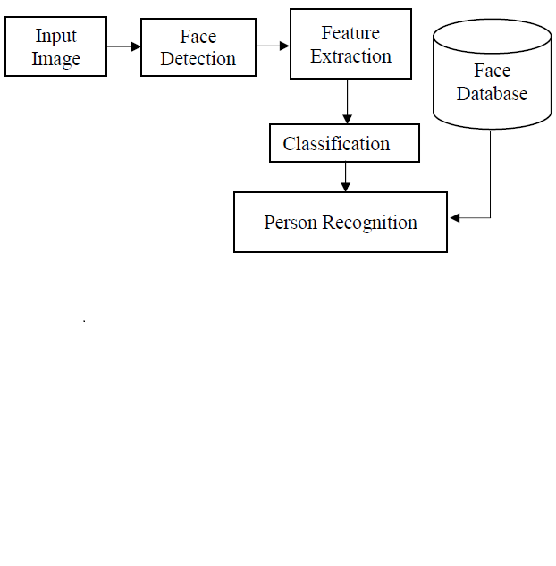
Block Diagram
Block diagram of various stages of project

Slide 8
Expected Result
Automated Attendance Recording: The system will efficiently mark attendance in real-time by recognizing faces from live video feeds, eliminating the need for manual processes.
Accurate and Reliable Recognition: The use of deep learning algorithms will ensure accurate face detection and recognition, even under varying environmental conditions.
Secure and Scalable Cloud Storage: Attendance records and student data will be securely stored in Firebase, with asynchronous updates ensuring smooth scalability for larger datasets.
Fraud Prevention with Anti-Spoofing: The system will prevent misuse through photos or digital images, ensuring attendance is marked only for physically present individuals.

Slide 9
Work – Plan
Months Activities | Jul’24 | Aug’24 | Sep’24 | Oct’24
Literature Reviews | √
Requirement Analysis | √
Designing | √
Experimental Analysis |  | √ | √
Module wise Implementation |  | √ | √
Testing and Debugging |  |  | √ | √
Preparation of Project Report |  |  |  | √

Slide 10
References
Schroff, F., Kalenichenko, D., & Philbin, J. (2015). FaceNet: A Unified Embedding for Face Recognition and Clustering. Proceedings of the IEEE Conference on Computer Vision and Pattern Recognition (CVPR), 815-823.
King, D. E. (2009). Dlib-ml: A Machine Learning Toolkit. Journal of Machine Learning Research, 10, 1755-1758.
Firebase Documentation (2023). Google Cloud, https://firebase.google.com/docs

Slide 11
Thank you !

